Slide 1
CSI3344 Distributed Systems
Lecture 6
SYNCHRONIZATION
Contents
6.1 Logical Clocks
6.2 Distributed Transactions Major Points

Slide 2
CSI3344 Distributed Systems
Objectives
Describe the principles of the use of logical clocks in distributed systems;
Be familiar with general properties of distributed transactions.
Notes:
Synchronize: to occur at the same time or coincide or agree in time;
to go on, move, operate, work, etc. at the same rate and exactly together.

Slide 3
Introduction (1)
Synchronization ensures that multiple processes do not simultaneously access a shared resource
Strongly related to communications between processes, e.g., how processes in distributed systems cooperate and synchronize.
Cooperation is partly supported by means of naming services, which allows processes to share entities or resources in distributed systems.
CSI3344 Distributed Systems
Notes:
Synchronization: Process of making two or more data storage devices or programs (in the same or different computers) having exactly the same information at a given time.
Use a message to Daniel
Message is written (start data communication)
Choose mail or fax (processes)
Fax to company
Daniel (not only one) Sumich (D S, not Peter S)
Department/company
Fax number
Mail to
Daniel (not only one) Sumich (D S, not Peter S)
Department/company
Address

Slide 4
Introduction (2)
One of the major features for distributed systems is no global clock – there is no single global notion of correct time.
Processes on different machines have their own idea of what time it is. In other words, a machine times events happened on it using its own physical clock attached to it.
In many cases, it is more important to know that related events at different processes happen in the correct order, rather than the absolute time when each event happens.
CSI3344 Distributed Systems
Notes:
Use a message to Daniel
Message is written (start data communication)
Choose mail or fax (processes)
Fax to company
Daniel (not only one) Sumich (D S, not Peter S)
Department/company
Fax number
Mail to
Daniel (not only one) Sumich (D S, not Peter S)
Department/company
Address

Slide 5
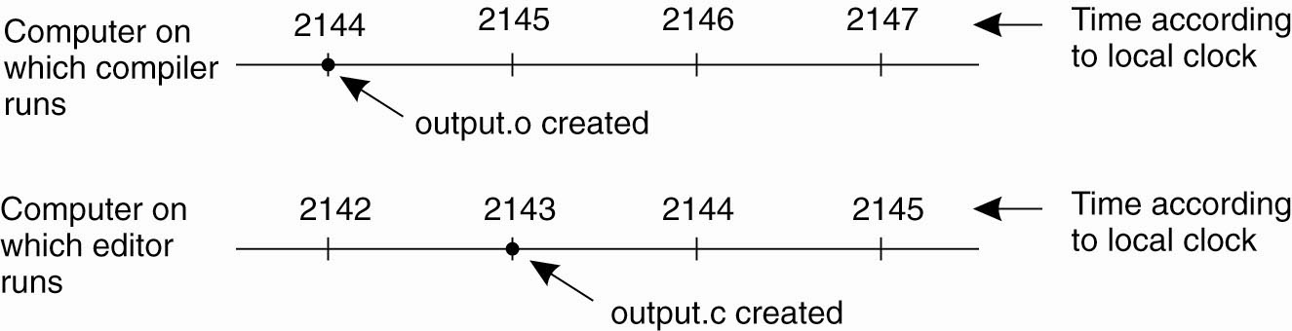
Clock Synchronization
Example 6.1: C Compiler and Make program in UNIX
Large applications split into multiple C source files
Make requires re-compile only modified sources, not all
Easy control in single computer, but not in distributed systems
Figure 6-1. When each machine has its own clock, an event that occurred after another event may nevertheless be assigned an earlier time.
CSI3344 Distributed Systems
Notes:
After changing/editing a C source code, named output.c (in the 2nd machine), it is sent to the 1st machine to MAKE a new version executable code. However as the newly updated code was with a time stamp at time point 2143 (local time), and there was an initially compiled obj code output.o with a time stamp 2144, the MAKE may not re-compile the newly modified code because it sees that the output.c was older than the output.o thus considered as old version. - Therefore no re-compiling would happen.

Slide 6
6.1 Logical Clocks (1)
Happened-before relation or causal ordering
Invented by Lamport in 1978
A simple mechanism to order some events that occur at different processes, rather than to exactly time on them.
We cannot synchronize clocks perfectly across a distributed system
Partial ordering
Called happened-before relation, or causal ordering.
CSI3344 Distributed Systems

Slide 7
6.1 Logical Clocks (2)
The causal ordering is based on two simple rules (a before b, denoted a → b )
If a and b are events in the same process, and a occurs before b, then the order a → b is true.
Whenever a message is sent between processes, then the event of sending the message a occurred before the event of receiving message b. Thus the order a → b is also true.
CSI3344 Distributed Systems

Slide 8
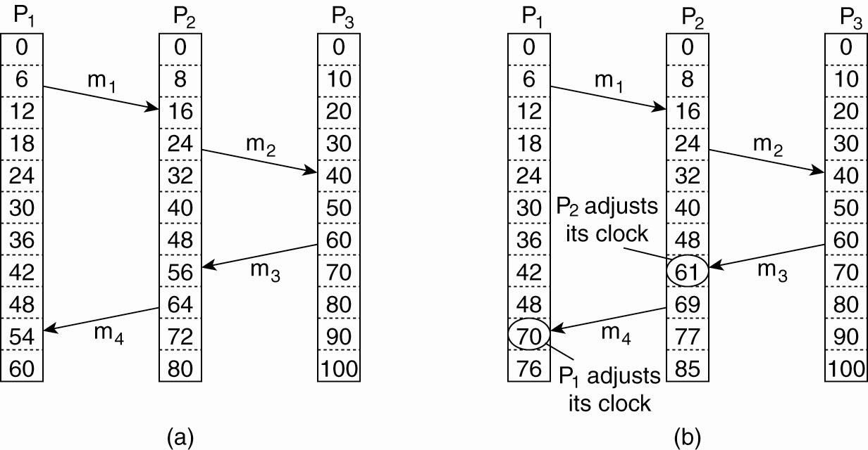
6.1 Logical Clocks (3)
Figure 6-9. (a) Three processes, each with its own clock. The clocks run at different rates.
CSI3344 Distributed Systems
Notes:
Time measurement units:
decisecond = 1/10 second
centisecond = 1/100 second
millisecond = 1/1,000 second
microsecond = 1/1,000,000 second
nanosecond = 10⁻⁹ second
picosecond = 10⁻¹² second
femtosecond = 10⁻¹⁵ second
attosecond = 10⁻¹⁸ second
zeptosecond = 10⁻²¹ second
yoctosecond = 10⁻²⁴ second

Slide 9
6.1 Logical Clocks (4)
Event of sending a message is always before the event of receiving the message
Figure 6-9. (b) Lamport’s algorithm corrects the clocks.
CSI3344 Distributed Systems

Slide 10
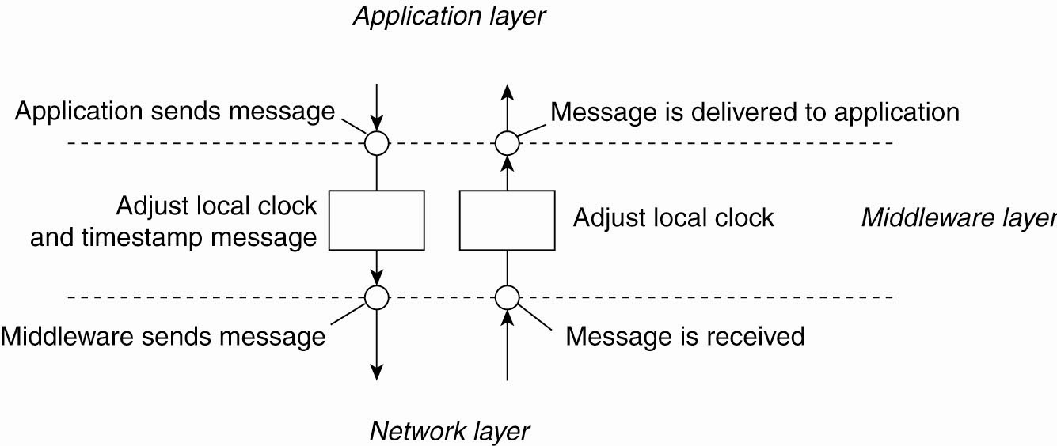
6.1 Logical Clocks (5)
Figure 6-10. The positioning of Lamport’s logical clocks in distributed systems.
CSI3344 Distributed Systems

Slide 11
6.1 Logical Clocks (6)
Lamport: Updating counter C_{i} for process P_{i}
Before executing an event P_{i} executes C_{i} ← C_{i} + 1.
When process P_{i} sends a message m to P_{j}, it sets m’s timestamp ts (m) equal to C_{i} after having executed the previous step.
Upon the receipt of a message m, process P_{j} adjusts its own local counter as C_{j} ← max{C_{j} , ts (m)}, after which it then executes the first step and delivers the message to the application.

Slide 12
6.1 Logical Clocks (7)
Full expression of happened-before relation
If a and b are events in the same process, and a occurs before b, then the order a → b is true.
Whenever a message is sent between processes, the event of sending the message a occurred before the event of receiving message b. Thus the order a → b is also true.
If a → b and b → c are true, then the order a → c is also true (i.e., transitive relation)
If a and e occur at different processes, and there is no any link between them, then events a and e are said to be concurrent, written as a // e (neither a → e nor e → a is true).
CSI3344 Distributed Systems

Slide 13
6.1 Logical Clocks (8)
Example 6.2: Events occurring at three processes
p1: a → b (true); p2: c → d (true); p3: e → f (true).
p1 to p2: b → c (true); p2 to p3: d → f (true).
p1 to p2: a → c (true); p2 to p3: c → f (true); p1 to p2 to p3: a → f (true); ……
p1 to p3: a // e, b//e (concurrent). ……
CSI3344 Distributed Systems
13

Slide 14
6.1 Logical Clocks (9)
Logical time and logical clock
The happened-before relationships can be captured numerically by assigning a logical time value, L(e), to a particular event e on which all processes agree.
The time value L(e) assigned to the event e is called the logical time of that event
The mechanism to assign such time value is called the logical clock.
CSI3344 Distributed Systems

Slide 15
6.1 Logical Clocks (10)
Lamport timestamp
A method to assign logical time value L(e) to a particular event e which follows the happened-before relation. This method piggybacks timestamps on all events in a distributed system subject to the following conditions:
If a happens before b in the same process, L(a) < L(b), or L(b) = L(a) + a positive number.
If a and b represent sending and receiving a message, respectively, L(a) < L(b).
For all distinctive events a and b that do not belong to the above cases, L(a) ≠ L(b).
The logical clock time L must always go forward (increasing).
CSI3344 Distributed Systems

Slide 16
6.1 Logical Clocks (11)
How do Lamport timestamps order events?
Example 6.3: Lamport timestamps for three processes
L1(a) = 1
L1(b) = 3
p
1
a
b
m
1
L2(c) = 4
L2(d) = 5
Physical
p
2
time
c
d
m
2
L3(e) = 2
L3(f) = 6
p
3
e
f
Question: How about setting L1(b) =2 and L3(e) = 3? Does this conflict with Lamport timestamps ordering rule?
CSI3344 Distributed Systems
16

Slide 17
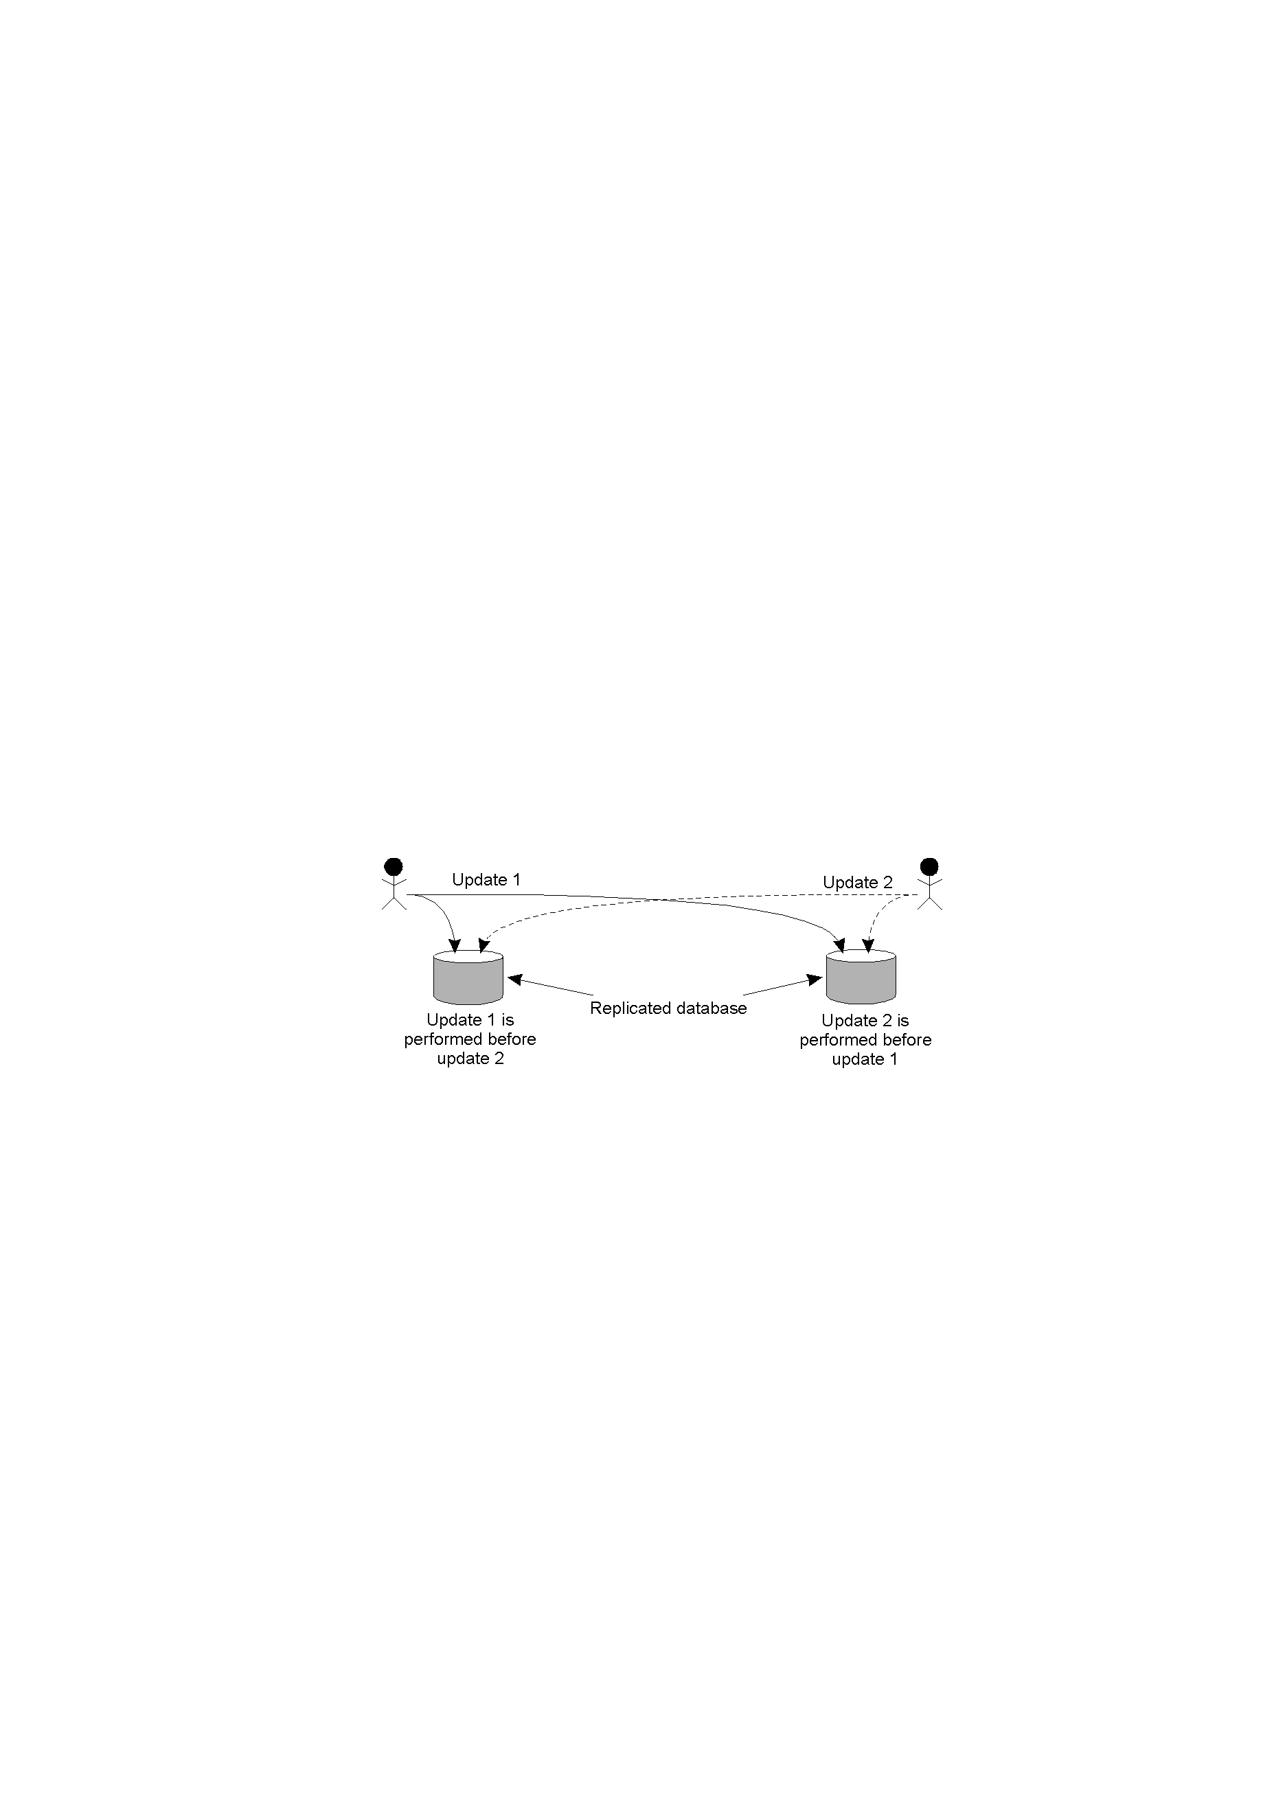
6.1 Logical Clocks (12)
How do Lamport timestamps order events?
Example 6.4: updating a replicated database system using physical clock
Bank account balance: $1000.
– user1: deposit $100; user2 (system agent): interest up 1%.
If u1 before u2-> balance will be: ($1000+$100)+($1000+$100)*1%=$1111 (at set 1)
If u2 before u1 -> balance will be: ($1000 + $1000 *1%) + $100 = $1110 (at set 2)
Data set 1
Data set 2
CSI3344 Distributed Systems
17

Slide 18
6.1 Logical Clocks (13)
How do Lamport timestamps order events?
The previous example requires totally-ordered multicast
The two updates at the two replica of the database be performed in the same order, no matter which operation (either deposit or interest raising) is processed first.
Totally-ordered multicast: messages are delivered in the same order to each receiver.
Sender: Each message is timestamped with the local time; When multicasted, the message is also sent to the sender;
Receiver: When receives a massage, it puts the message into the local queue, ordered according to the message’s adjusted timestamp (i.e., using Lamport’s algorithm). The receiver then multicast an acknowledgement to all other processes.
Result: all processes have the same copy of the local queue, (i.e., all messages are delivered in the same order everywhere)
Assumptions:
Messages from the same sender are received in the same order; and
No messages are lost.
18
CSI3344 Distributed Systems

Slide 19
6.1 Logical Clocks (14)
How do Lamport timestamps order events?
Example 6.5: updating a replicated database system using Lamport timestamps – totally-ordered multicasting
Account balance: $1000.
- u1: deposit $100; u2: interest up 1%
p2(2)
L1(u2)=2.2
p2(2)
Sender/ receiver 1
p1(2)
L2(u1)=1.2
p1(2)
Sender/ receiver 2
p2(1)
L2(u2)=2.1
p2(1)
p1(1)
L1(u1)=1.1
p1(1)
Message queue
L1(u2)=2.2
Database replica 1
u2
L2(u2)=2.1
u2
Database replica 2
L2(u1)=1.2
u1
L1(u1)=1.1
u1
CSI3344 Distributed Systems

Slide 20
6.1 Logical Clocks (14)
How do Lamport timestamps order events?
Example 6.5: updating a replicated database system using Lamport timestamps – totally-ordered multicasting
Account balance: $1000.
- u1: deposit $100; u2: interest up 1%
p2(2)
L1(u2)=2.2
p2(2)
Sender/ receiver 1
p1(2)
L2(u1)=1.2
p1(2)
Sender/ receiver 2
p2(1)
L2(u2)=2.1
p2(1)
p1(1)
L1(u1)=1.1
p1(1)
Or, may be this way?
Message queue
L2(u1)=1.2
Database replica 1
u1
L1(u1)=1.1
u1
Database replica 2
u2
L1(u2)=2.2
u2
L2(u2)=2.1
CSI3344 Distributed Systems

Slide 21
6.1 Logical Clocks (14)
How do Lamport timestamps order events?
When a group of processes multicast messages to each other, each message is timestamped with the current (local) time of the sender;
The multicast message is also conceptually sent back to the sender
The receiver put received message into a local queue, ordered by its timestamp; and then multicasts an acknowledgement to all other processes;
Based on Lamport’s algorithm, the timestamp of the received message is always before the timestamp of the acknowledgement – this may cause adjustment of local logical clock of a sender
=> Each process has the same copy of the queue, all messages are delivered in the same order everywhere, i.e., Totally-Ordered Multicasting
CSI3344 Distributed Systems

Slide 22
6.1 Logical Clocks (15)
Weakness of Lamport timestamp:
If a → b, then L(a) < L(b). 
If L(a) < L(b), it could be a → b or a // b . ??
Vector clock and vector timestamps
A vector clock for a system of N processes is an array of N integers. Each process keeps its own vector clock V_{i} to timestamp local events.
All processes piggyback vector timestamps on the messages they send to one another.
To determine the order of two events, all components of a vector timestamp need to be compared with those of the other, e.g.,
a → b iff for all i ( 1≤i≤N, L(V_{a}(i)) ≤ L(V_{b}(i))) and Ǝ j (1≤j≤N, L(V_{a}(j)) < L(V_{b}(j)))
CSI3344 Distributed Systems

Slide 23
6.1 Logical Clocks (16)
How do vector timestamps order events?
Example 6.6: vector timestamps for three processes
Equal value is allowed.
CSI3344 Distributed Systems
22

Slide 24
6.1 Logical Clocks (17)
How do vector timestamps order events?
Example 6.7: updating a replicated database system using vector timestamps
Account balance: $1000.
- u1: deposit $100; u2: interest up 1%
p2(2)
V(2, 2)
p2(2)
Sender/ receiver 1
p1(2)
V(1, 2)
p1(2)
Sender/ receiver 2
p2(1)
V(0,1)
p2(1)
p1(1)
V(1, 0)
p1(1)
Message queue
V(2, 2)
Database replica 1
u2
V(0, 1)
u2
Database replica 2
V(1, 2)
u1
V(1, 0)
u1
CSI3344 Distributed Systems

Slide 25
6.1 Logical Clocks (17)
How do vector timestamps order events?
Example 6.7: updating a replicated database system using vector timestamps
Account balance: $1000.
- u1: deposit $100; u2: interest up 1%
p2(2)
V(2, 2)
p2(2)
Sender/ receiver 1
p1(2)
V(1, 2)
p1(2)
Sender/ receiver 2
p2(1)
V(0,1)
p2(1)
p1(1)
V(1, 0)
p1(1)
Or, may be this way?
Message queue
V(1, 2)
Database replica 1
u1
V(1, 0)
u1
Database replica 2
V(2, 2)
u2
V(0, 1)
u2
CSI3344 Distributed Systems

Slide 26
6.2 Distributed Transactions (1)
Functions of distributed transactions
Distributed transactions in a distributed system are able to:
Protect a shared resource against simultaneous access by several concurrent processes;
Protect the integrity of shared data (i.e., the all-or-nothing property).
CSI3344 Distributed Systems

Slide 27
6.2 Distributed Transactions (2)
All-or-nothing property
Example 6.8: Transfering money between two accounts online
A bank customer transfers money from a savings account to a cheque account, the transaction might consist of three separate operations: (i) decrease the savings account; (ii) increase the cheque account; and (iii) record the transaction in the transaction log.
The system must guarantee that all three operations are performed to maintain the accounts in proper balance. When something prevents one of the operations in the transaction from execution properly, all other operations of the transaction must be undone.
CSI3344 Distributed Systems

Slide 28
6.2 Distributed Transactions (3)
Classification of transactions
Flat transaction
Properties of ACID.
Nested transaction
Distributed transaction
CSI3344 Distributed Systems

Slide 29
6.2 Distributed Transactions (4)
Characteristic properties of flat transactions (ACID)
Atomic – To the outside world, the transaction happens indivisibly (all-or-nothing).
Consistent – The transaction does not violate system invariants (data integrity).
Isolated (or serializable) – Concurrent transactions do not interfere with each other (transaction ordering).
Durable: – Once a transaction commits, the changes are permanent (nonreversible).
CSI3344 Distributed Systems

Slide 30
6.2 Distributed Transactions (5)
Example 6.9: flight reservation
(Perth→Singapore →Frankfort →London)
Primitives to carry out transactions
Primitive | Description
BEGIN_TRANSACTION | Make the start of a transaction
END_TRANSACTION | Terminate the transaction and try to commit
ABORT_TRANSACTION | Kill the transaction and restore the old values
READ | Read data from a file, a table, or otherwise
WRITE | Write data to a file, a table, or otherwise
CSI3344 Distributed Systems
28

Slide 31
6.2 Distributed Transactions (6)
Example 6.9: flight reservation (cont…)
(Perth→Singapore →Frankfort →London)
Transactions
A: transaction commits B: transaction aborts
BEGIN_TRANSACTION reserve Perth → Singapore; reserve Singapore → Frankfort; reserve Frankfort → London; END_TRANSACTION (A) | BEGIN_TRANSACTION reserve Perth → Singapore; reserve Singapore → Frankfort; reserve Frankfort → London full => ABORT_TRANSACTION (B)
Weakness of flat transactions
Flat transactions do not allow partial results to be committed.
CSI3344 Distributed Systems
29

Slide 32
6.2 Distributed Transactions (7)
Nested transactions
Constructed from a number of sub-transactions.
The higher-level transaction is called a parent transaction of the transactions on next level, and thus all subtransactions are called child transactions (T1, T2, T12, T211).
T : top-level transaction
T
1
= openSubTransaction
T
2
= openSubTransaction
prov. commit
T
1
:
T
2
:
openSubTransaction
openSubTransaction
openSubTransaction
prov. commit
T
abort
T
11
:
T
12
:
21
:
openSubTransaction
prov. commit
prov. commit
T
:
prov. commit
211
CSI3344 Distributed Systems
30

Slide 33
6.2 Distributed Transactions (8)
Advantages of nested transactions
Subtransactions at one level may run concurrently with other subtransactions at the same level in the hierarchy.
Subtransactions can commit or abort independently. A parent can decide on different actions according to whether a subtransaction has aborted or not.
Example 6.10: deliver equipment to all staff: university →schools → individuals
CSI3344 Distributed Systems

Slide 34
6.2 Distributed Transactions (9)
Operation rules of nested transactions
Parent transaction:
may commit or abort only after its child transactions have completed (fully or partially).
When a parent transaction aborts, all of its subtransactions abort.
Subtransaction:
When completed, it makes an independent decision either to commit provisionally or abort finally.
When aborted, the parent transaction can decide whether to abort or not.
If the top-level transaction commits, then all sub-transactions that have provisionally committed can commit too. Condition: each subtransaction works on a separate database.
CSI3344 Distributed Systems

Slide 35
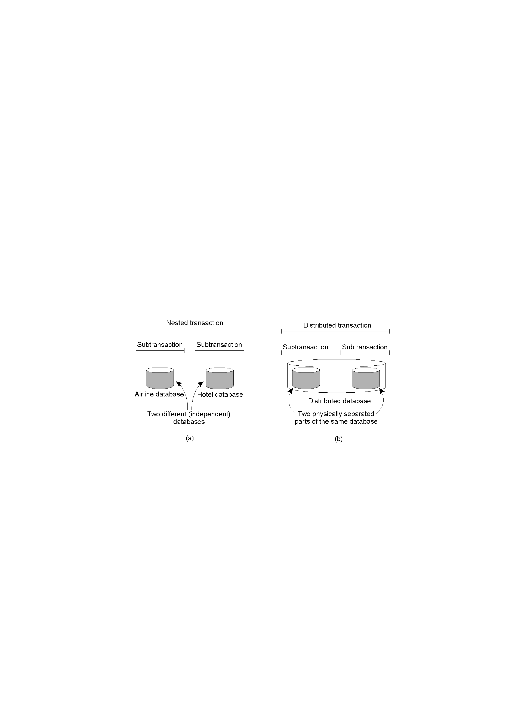
6.2 Distributed Transactions (10)
Distributed transactions
A distributed transaction is logically a flat, indivisible transaction that works on distributed data.
CSI3344 Distributed Systems

Slide 36
Major Points
Full expression of happened-before relation.
Given a multi-process diagram, to be able to analyze the relationship between two processes.
What is ACID?
What is the major difference between nested and distributed transactions?
CSI3344 Distributed Systems
34

Slide 37
Reading Guide
Normal Reading:
DSPP: 6.1.1, 6.2, 6.3.1~2, 1.3.1~2
DSCD: 10.4, 10.5
Advanced Readings
DSPP: 6.3.3~6
Mutual Exclusion
CSI3344 Distributed Systems
35

